Slide 1
World Round-Up Judging Instructions

Slide 2
The World Round-Up Judging Criteria
1. Skaters' names are entered in order of their past performance ratings. Lowest scoring skaters are listed first and will skate first
2. Each skater is allowed two runs of 1 1/2 minutes.
3. Five judges score each skater's run.
4. The Low and High Scores for each skater are discarded.
5. The remaining three Judge's scores are used to determine the winner.
6. In case of a tie score, the second run is used to break the tie.
7. If a tie still occurs, all five judges' scores will be used to break the tie.

Slide 3
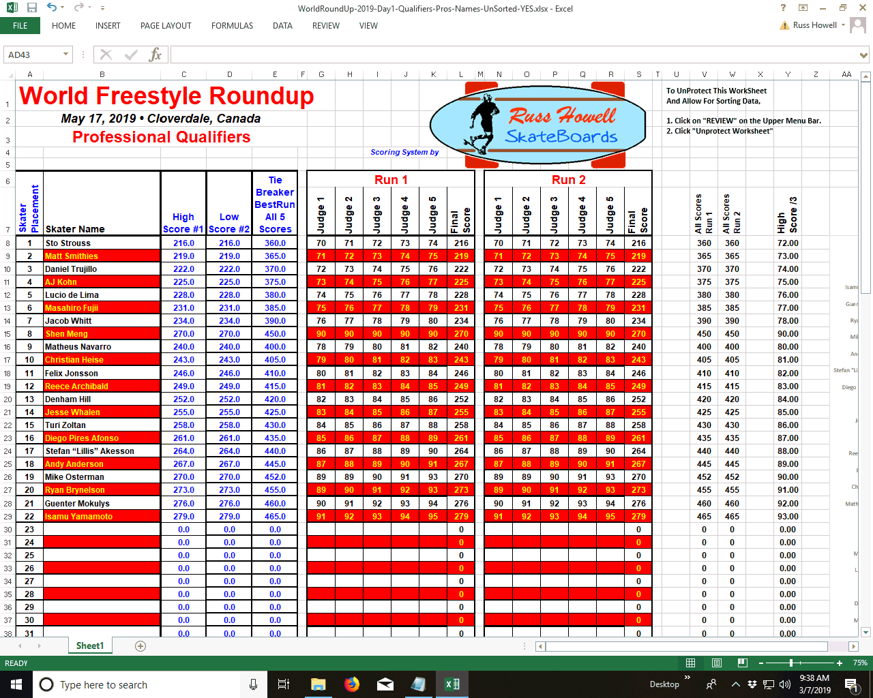
World Round-Up
Excel Spreadsheet
Scoring Instructions
The Scoring Spreadsheet is "LOCKED" to prevent erasing important cells.
Enter Judges' Scores for all Skaters' Runs.
Image #1

Slide 4
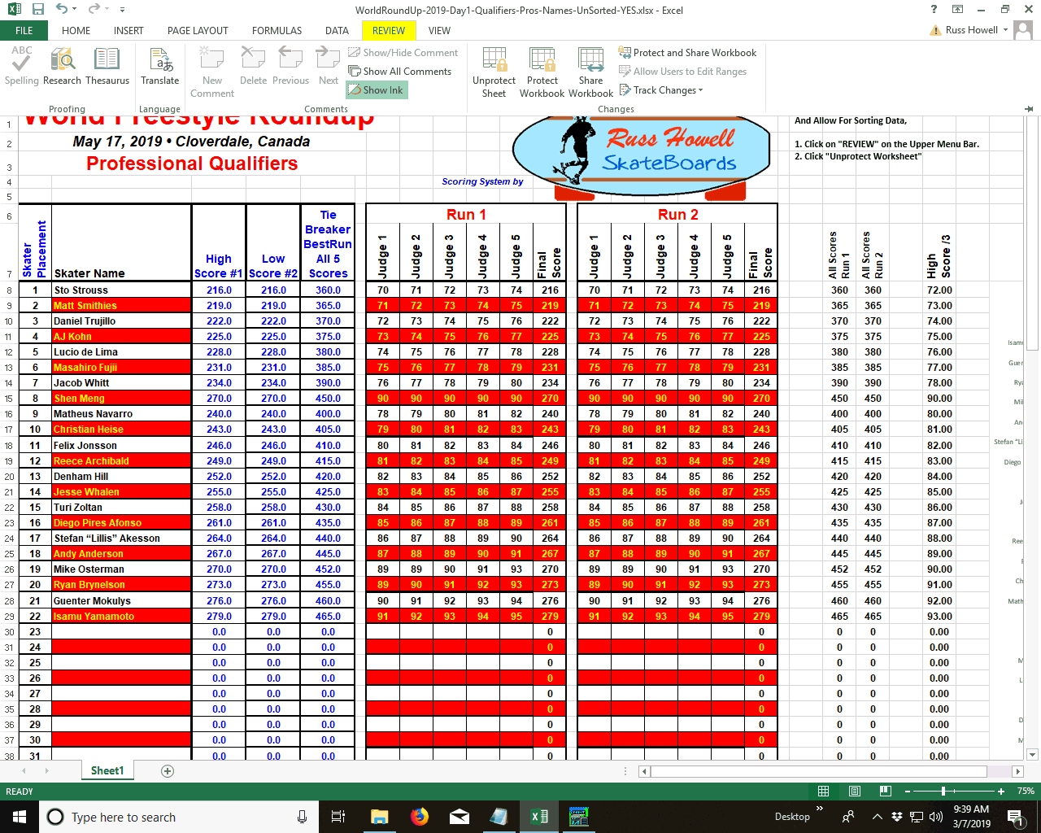
World Round-Up
Excel Spreadsheet
Scoring Instructions
Sorting the Skaters' Scores
Click on "Review" on the Upper Menu Bar
Image #2

Slide 5
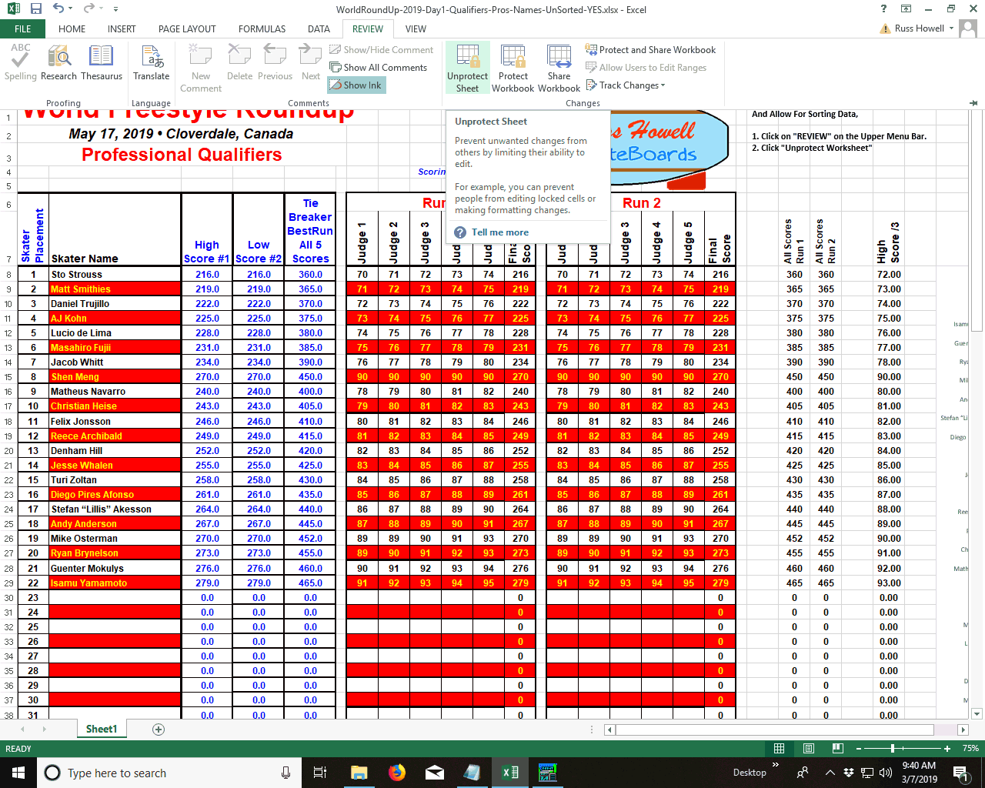
World Round-Up
Excel Spreadsheet
Scoring Instructions
Choose "UnProtect Sheet"
Image #3

Slide 6
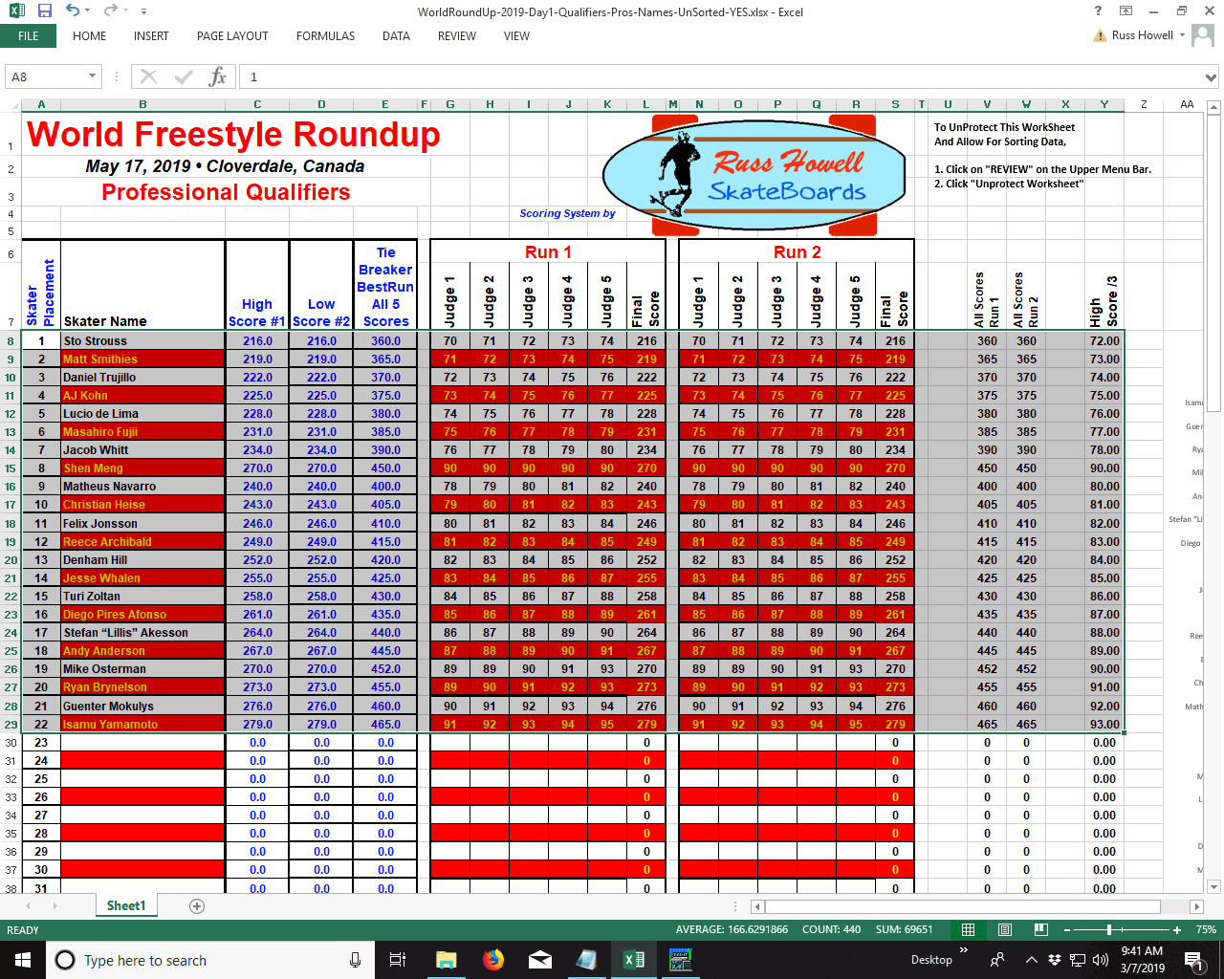
World Round-Up
Excel Spreadsheet
Scoring Instructions
Highlight All Rows for Skaters
Image #4

Slide 7
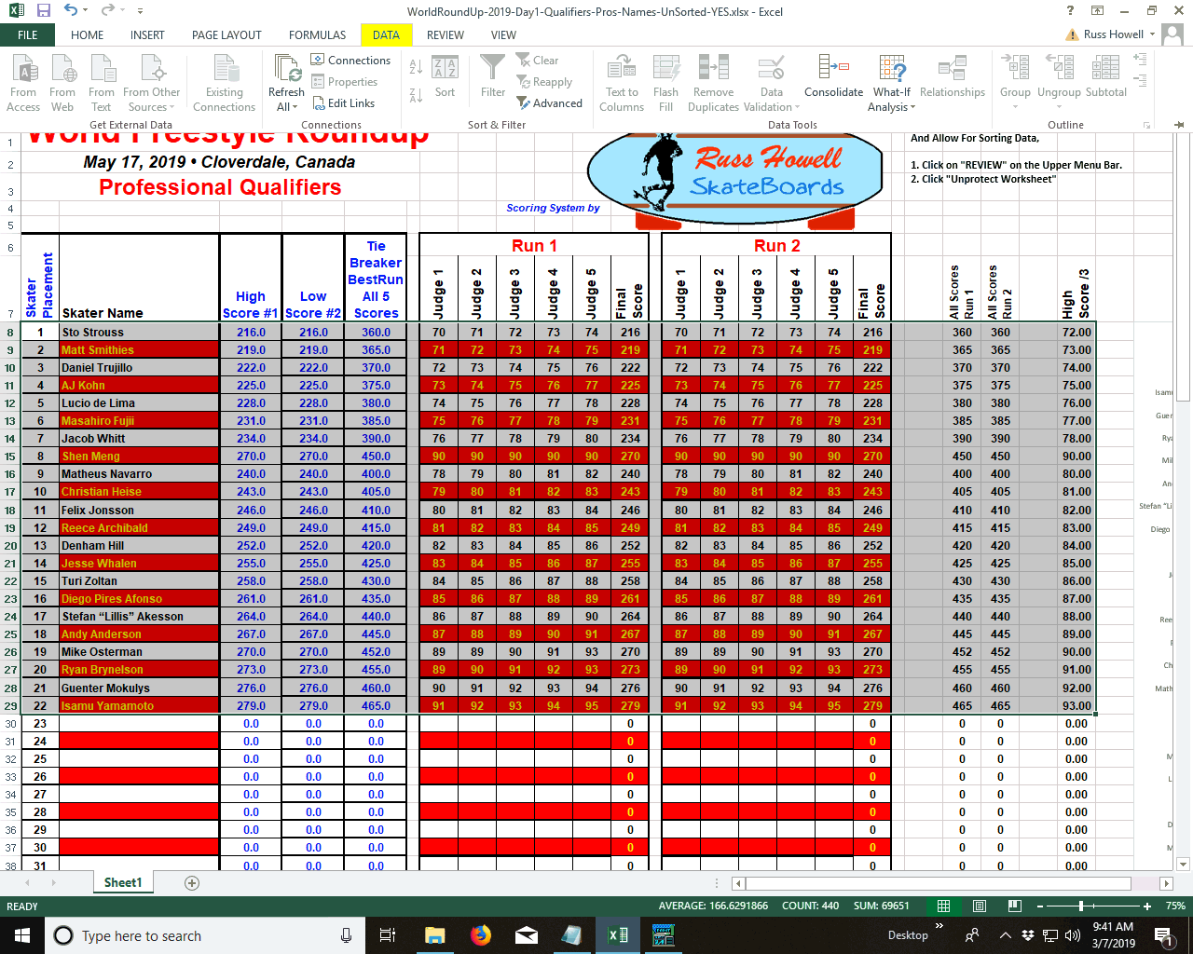
World Round-Up
Excel Spreadsheet
Scoring Instructions
Click on "Data" on the Upper Menu Bar
Image #5

Slide 8
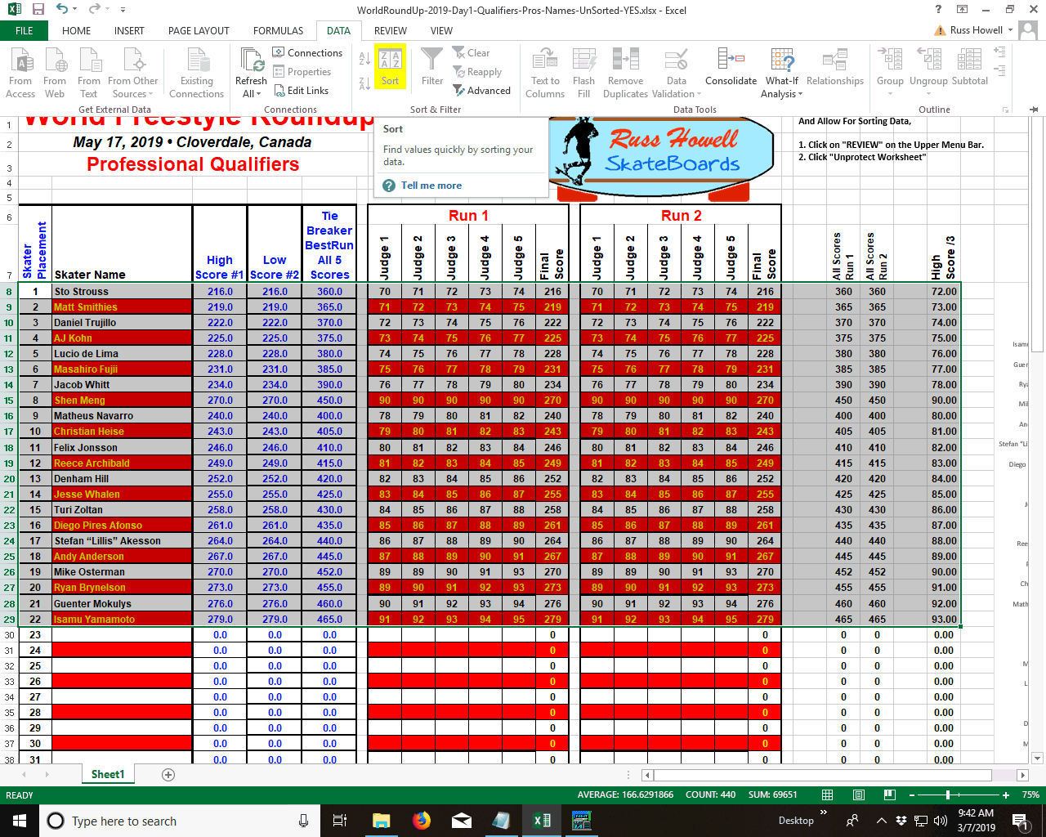
World Round-Up
Excel Spreadsheet
Scoring Instructions
Choose the "Sort" option
Image #6

Slide 9
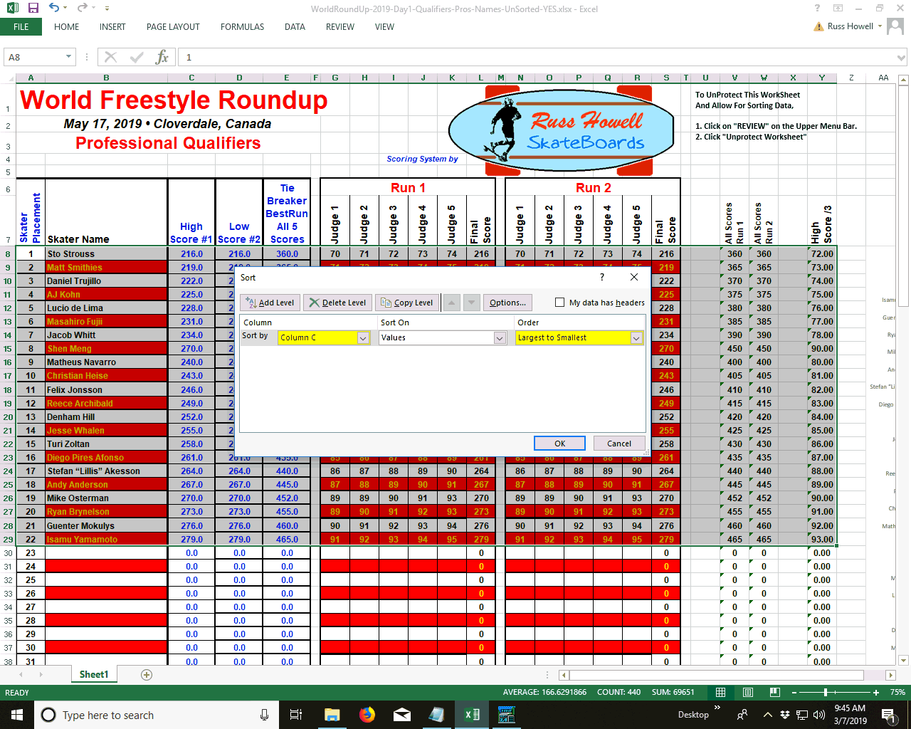
World Round-Up
Excel Spreadsheet
Scoring Instructions
Fill In: Sort by "Column C" - Sort on "Values" - Order "Largest to Smallest"
Image #7

Slide 10
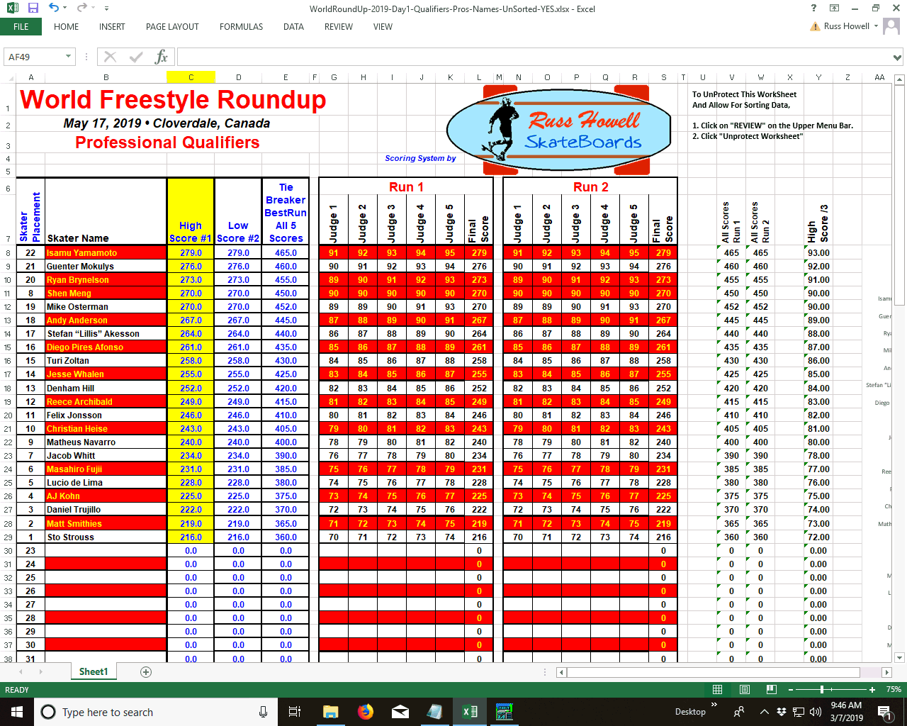
World Round-Up
Excel Spreadsheet
Scoring Instructions
The Skaters' Scores are now Sorted From Highest to Lowest
Using Column C
Image #8

Slide 11
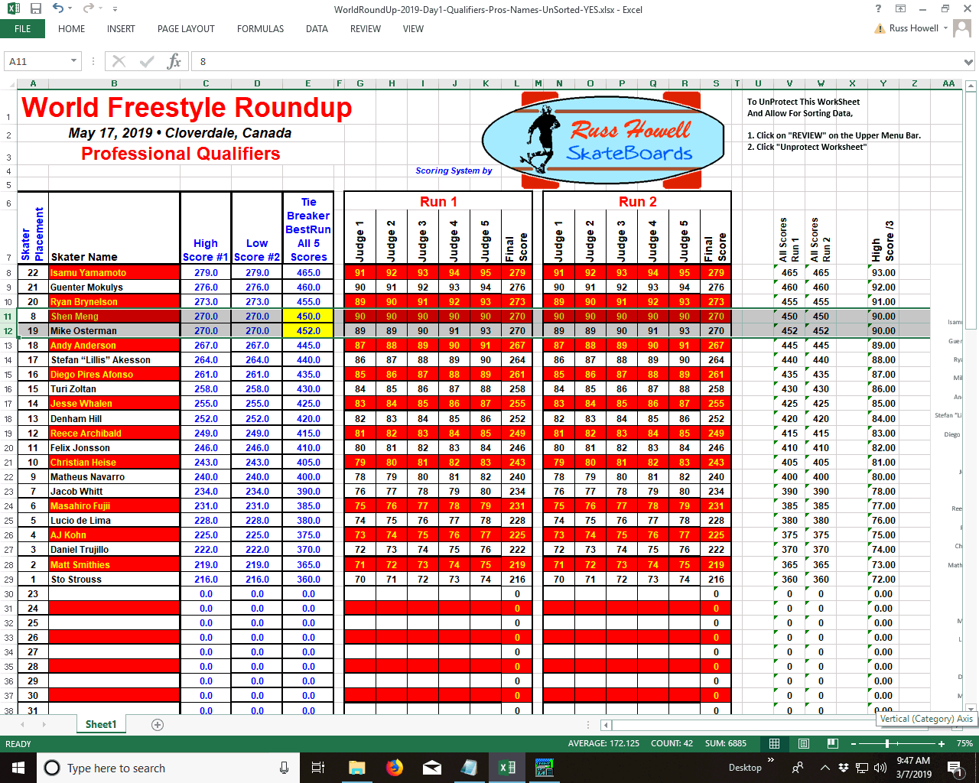
World Round-Up
Excel Spreadsheet
Scoring Instructions
Note that there is a "Tie" between Shen Meng and Mike Osterman. Both their Highest and Lowest Scores are "Tied“
Using All Five Judges' Scores Breaks the Tie
Mike Osterman's Score of 452 vs. Shen Meng's Score of 450
Image #9

Slide 12
World Round-Up
Excel Spreadsheet
Scoring Instructions
Highlight Both Rows for Shen Meng and Mike Osterman
Image #10

Slide 13
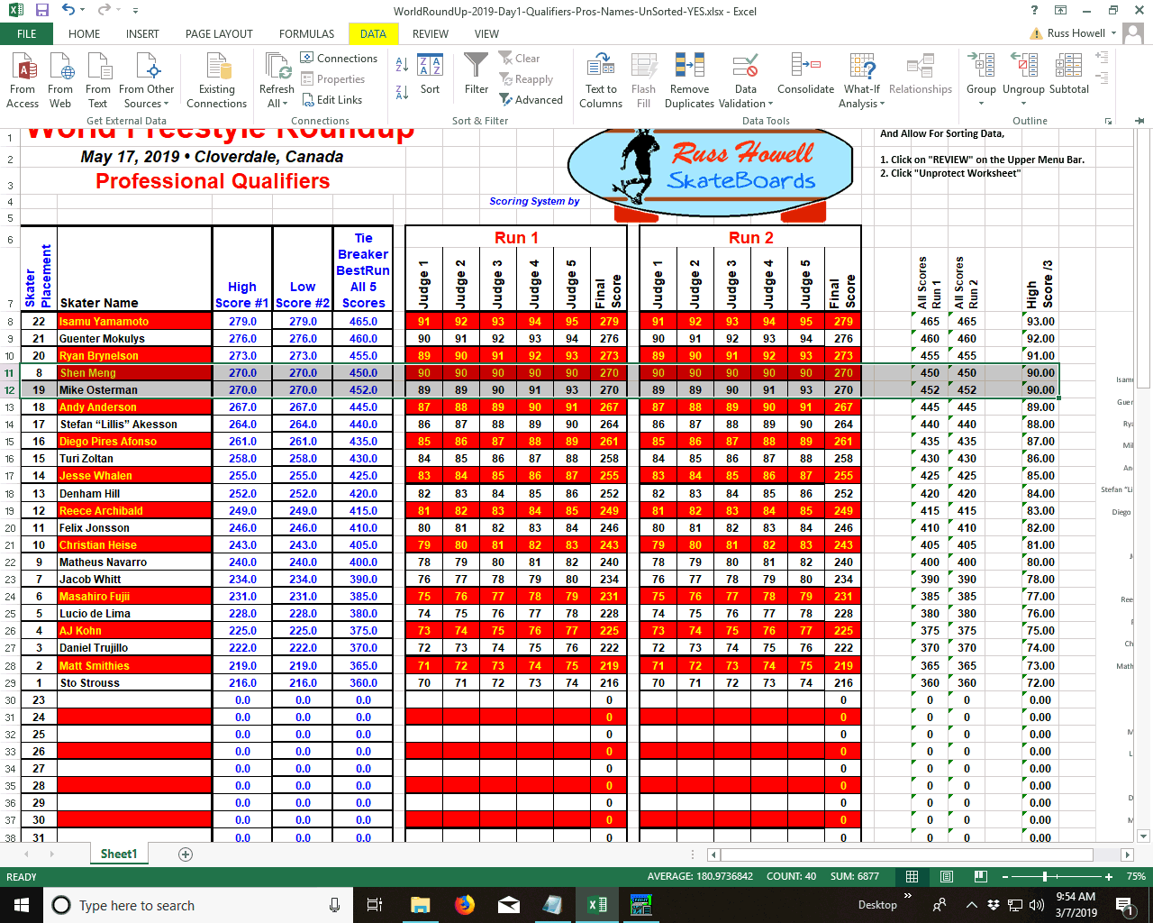
World Round-Up
Excel Spreadsheet
Scoring Instructions
Click on "Data" on the Upper Menu Bar
Image #11

Slide 14
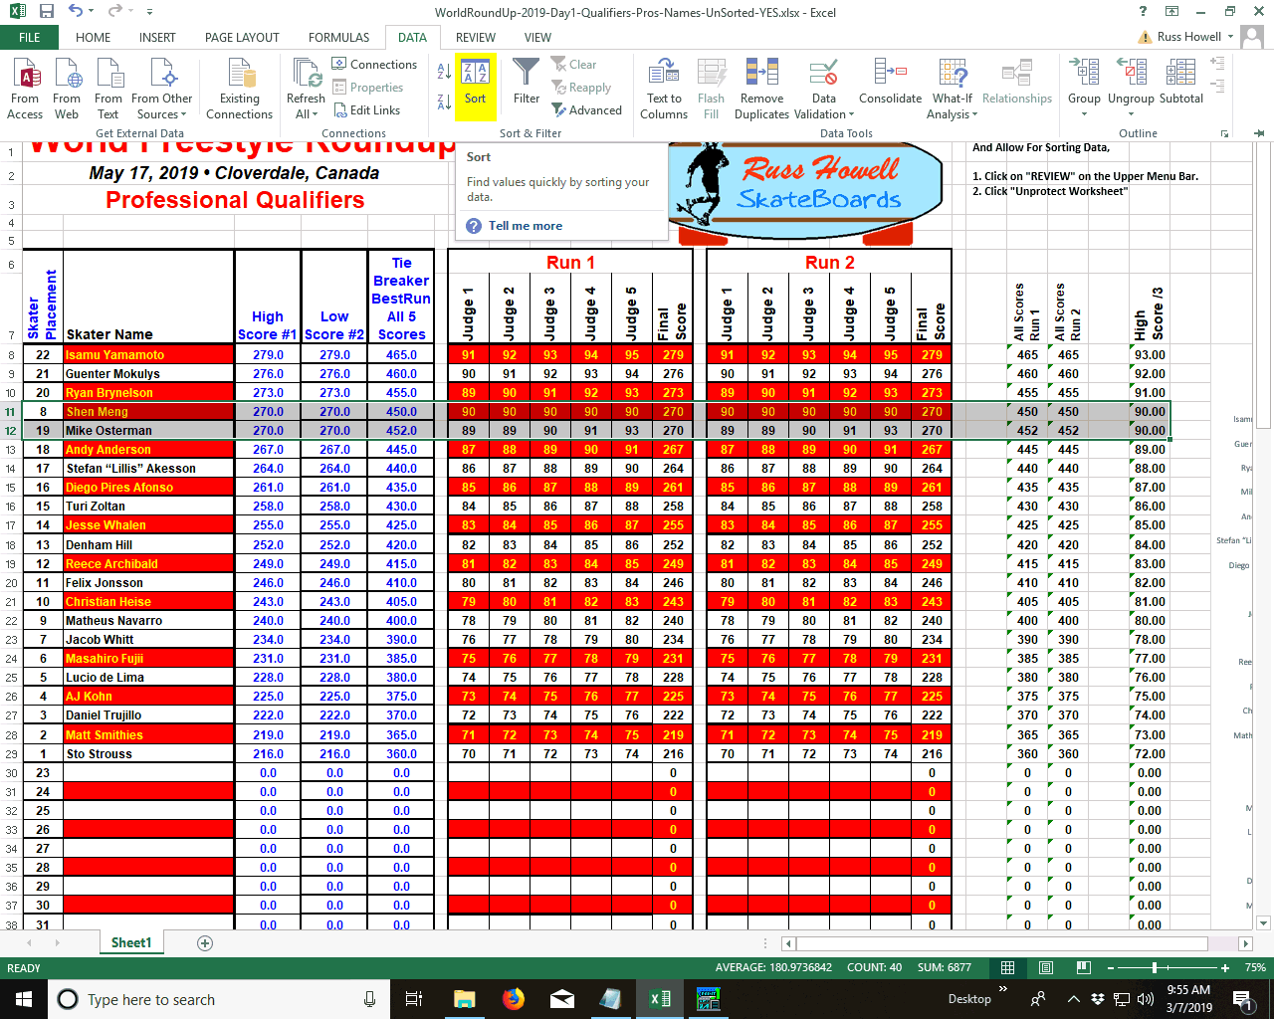
World Round-Up
Excel Spreadsheet
Scoring Instructions
Choose the "Sort" option
Image #12

Slide 15
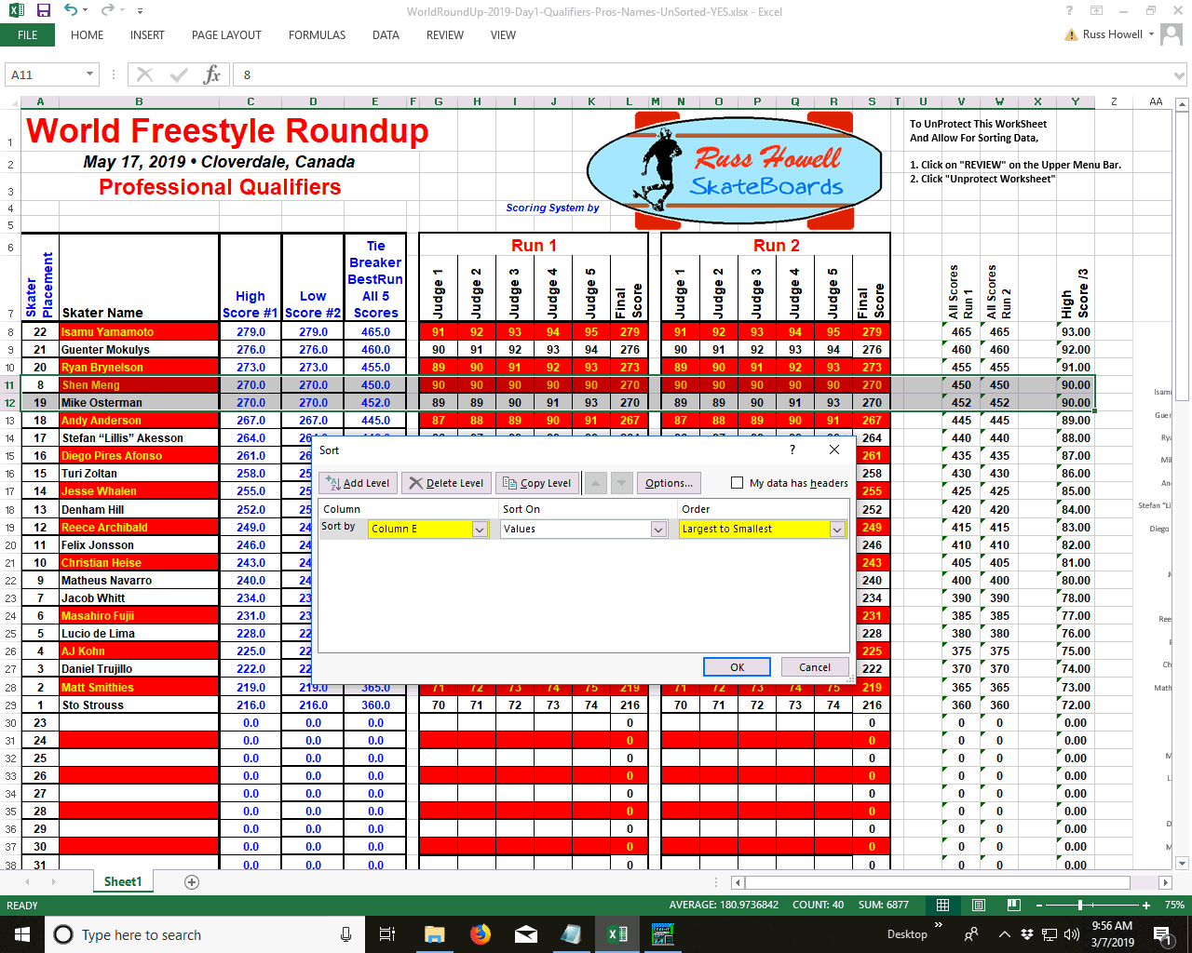
World Round-Up
Excel Spreadsheet
Scoring Instructions
Fill In:
Sort by "Column E“
Sort on "Values“
Order "Largest to Smallest"
Image #13

Slide 16
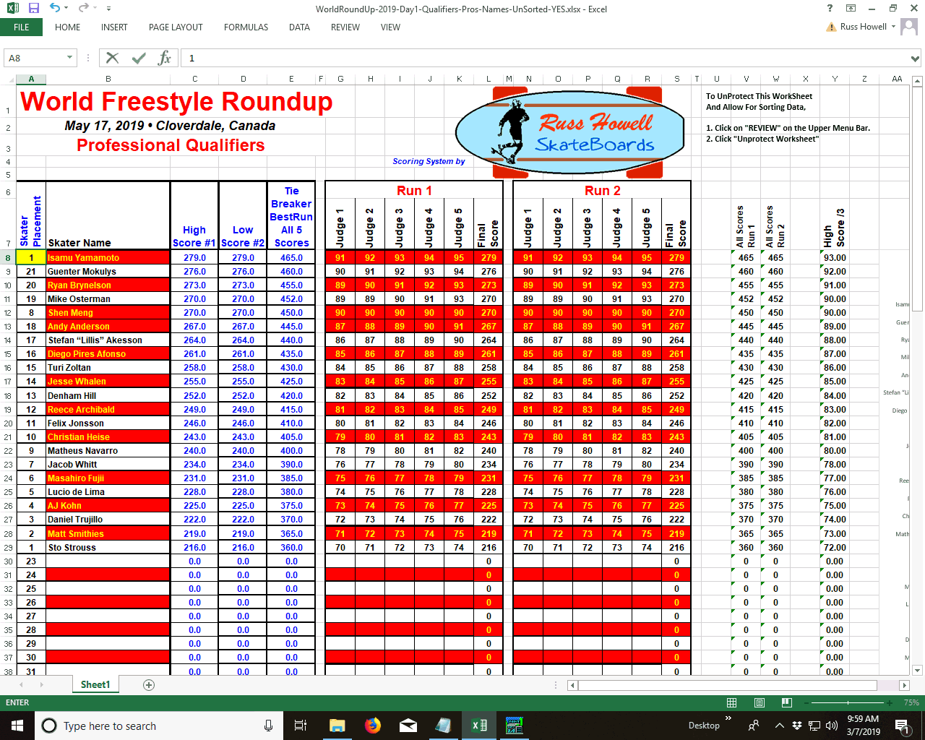
World Round-Up
Excel Spreadsheet
Scoring Instructions
Manually Number
The Placement Order
of Skaters in Column "A"
Replace Cell A8 with the Number "1"
Image #14

Slide 17
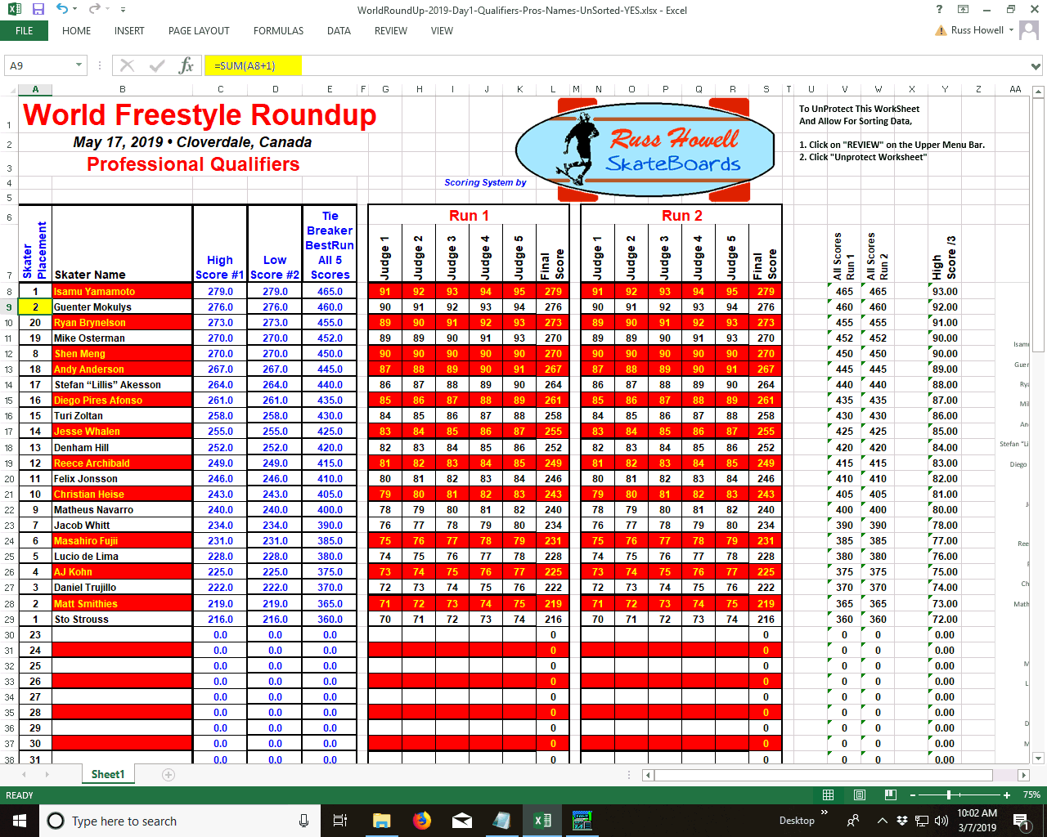
World Round-Up
Excel Spreadsheet
Scoring Instructions
Enter the following formula into Cell A9: =SUM(A8+1)
This formula adds "1" to the cell above it.
Image #15

Slide 18
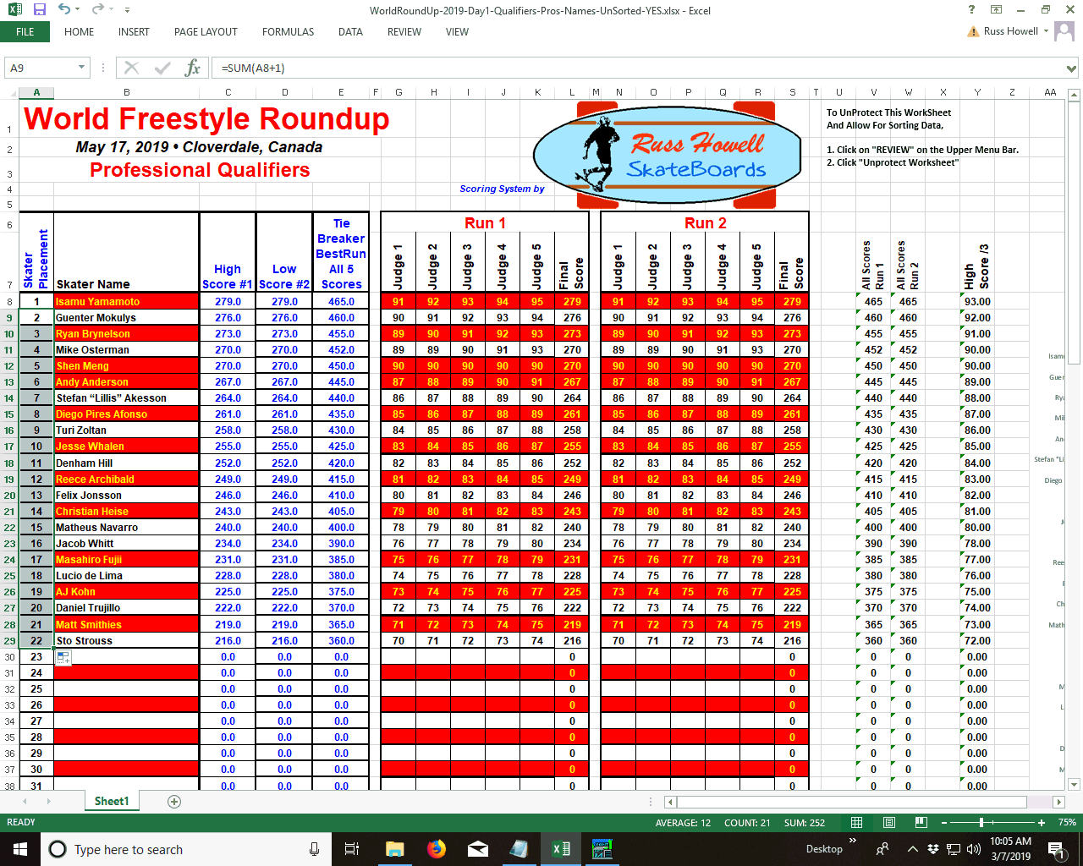
World Round-Up
Excel Spreadsheet
Scoring Instructions
Highlight Cell "A9
Click-and-Drag down to the last Skater's Cell in Column "A"
This Automatically Numbers the Placement Order for Skaters.
Image #16

Slide 19
World Round-Up
Excel Spreadsheet
Scoring Instructions
The Scoring Sheet is now ready to Print Screen
(Screen Capture - PrtSc)
Image #17

Slide 20
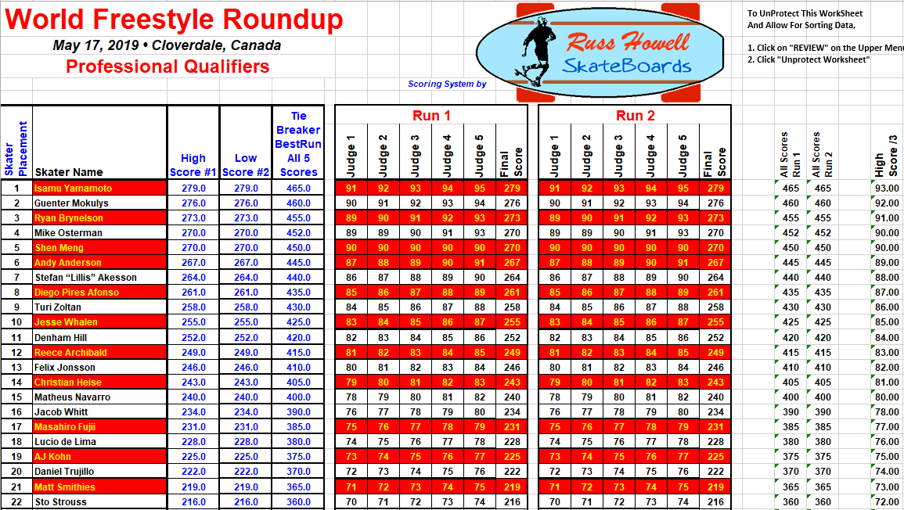
World Round-Up
Excel Spreadsheet
Scoring Instructions
The Screen Capture can be edited for Printing
Image #18

Slide 21
World Round-Up
Excel Spreadsheet
Scoring Instructions
Contact Russ Howell
For Further Information
E-Mail:
russwebdesigns@yahoo.com
Scoring Spreadsheets
Available On Request

